Slide 1
Duplicate Question-Pair Classification In Quora Questions Dataset
Zahiduzzaman Biswas
Instructor: Jan Zikes

Slide 2
GOAL
Train a model that takes two questions as input and classify them either as
1 (duplicate) or
0 (not duplicate
Mathematical representation :
f(question1, question2) = 1 or 0

Slide 3
WHY IS IT NEEDED?
For Quora
For Quora Users
To remove duplicates and organize answers in one thread
To provide best user experience
To reduce data storage usage
To avoid the maze of answers
To avoid asking duplicate questions
To be more efficient

Slide 4

Motivation
First official release on January 24, 2017
http://qim.fs.quoracdn.net/quora_duplicate_questions.tsv
Competition was hosted on Kaggle.com
Source: https://www.kaggle.com/c/quora-question-pairs

Slide 5
DATA EXPLORATION
Training Data: train.csv Rows: 404290 Column: 6 Memory: 64MB
id | qid1 | qid2 | question1 | question2 | Is_duplicate
0 | 1 | 2 | What is the step by step guide… | What is the step by step guide to invest | 0
1 | 3 | 4 | What is the story of (Koh-i-Noor) Diam… | What would happen if Indian Government.. | 0
Test Data: test.csv Rows: ~2.3 Million (3.5Million+) Column: 3 Memory: 314MB
test_id | question1 | question2
0 | How does the Surface Pro himself 4 compare wit.. | Why did Microsoft choose core m3 and not core ..
1 | Should I have a hair transplant at age 24? How... | How much cost does hair transplant require?

Slide 6
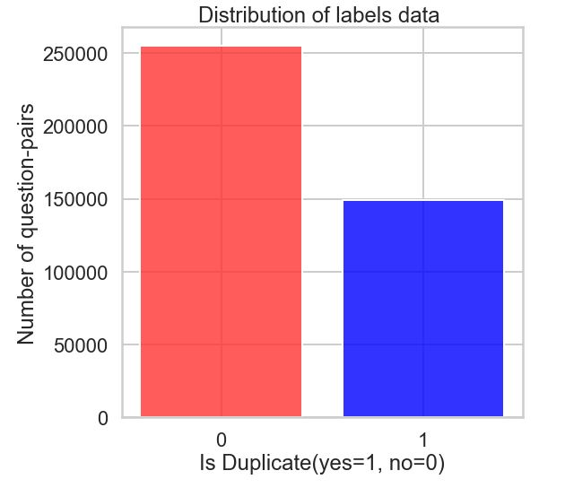
TRAINING DATA EXPLORATION
Missing Values : 3
Duplicate questions pair : 40%
Real questions from Quora
Labels are not 100% accurate
Note: Test data is computer Generated

Slide 7
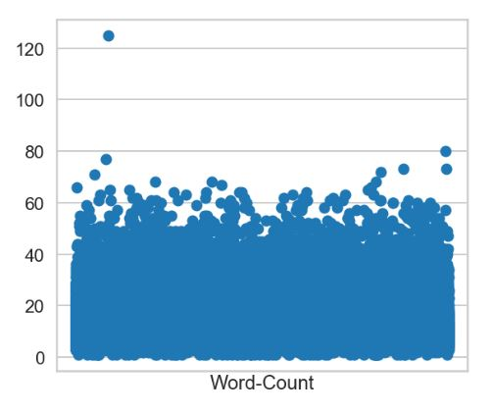
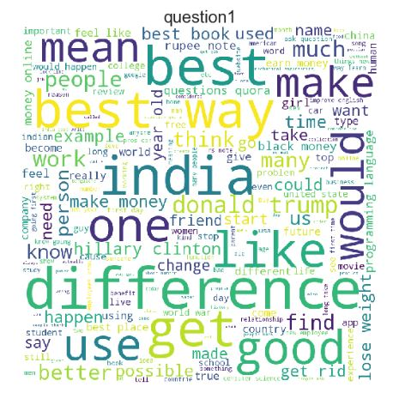
EDA of ‘question1’ Column
Max word Count : 125
Min word count : 1

Slide 8
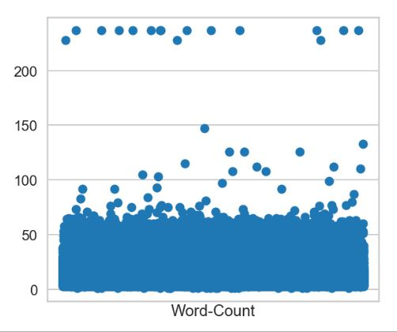
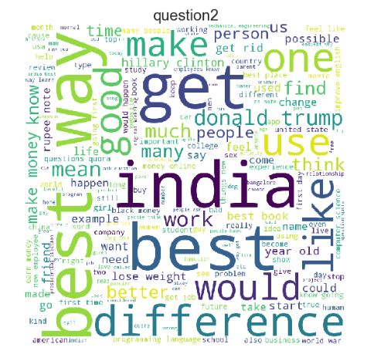
EDA of ‘question2’ Column
Max word Count : 237
Min word count : 1

Slide 9
Insights
Most of the questions are about India, US politics, economics etc.
Questions are asked from different perspective
Intent of the questions are subjective
Is it really possible accurately identify the intent of a question?
Challenge: can our model predict the questions with same intent?
What is the step by step guidance to invest in share market?
What is the step by step guidance to invest in share market in India?
How is the new Harry Potter book ‘Harry Potter an the Cursed Child’?
How bad is the new book by J. k Rowling?

Slide 10
Our Approach
Step 1 Text Preprocessing
Remove Clutters
Step 2 Vectorizations
Tf-idf
doc2vec
Step 3 Feature Selections and Modeling
Add features (word-count, character-count, cosine distance, Euclidean distance, doc2vec)
Naïve Bayes
Stem and corrections

Slide 11
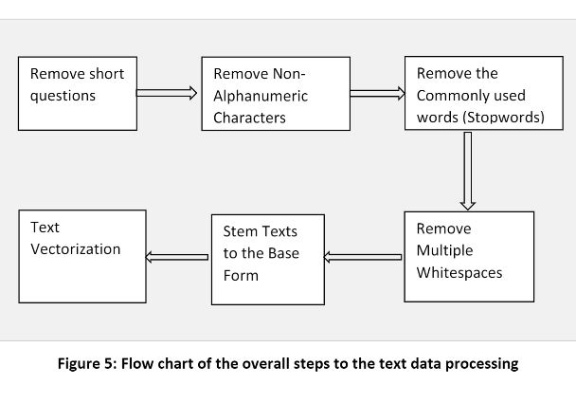


Add a Slide Title - 2
Naïve Bayes Algorithm
Features are independent
Order of word does not matter
Evaluation Metrics
Log loss
Prediction Probability

Slide 12
Experiments and Results
Model No. | Model Specs. | Parameters | Public Score | Private Score
3 | Tf-idf vectorization Doc2vec Trained on Questions Corpus Multinomial Naïve Bayes | MultinomilaNB : α = 0.1 TfidfVectorizer: min_df = 1 , ngram = (1,2) Doc2Vec: Window = 1, epochs = 1, min_count = 1, vector_size = 5 | 0.398 | 0.399
4 | Tf-idf vectorization Doc2vec Trained on Questions Corpus Multinomial Naïve Bayes | MultinomilaNB : α = 0.1 TfidfVectorizer: min_df = 1 , ngram = (1,2) Doc2Vec: Window = 7, epochs = 10, min_count = 2, vector_size =100 | 0.390 | 0.398

Slide 13
Experiments and Results (cont.)
Model No. | Model Specs. | Parameters | Public Score | Private Score
5 | Tf-idf vectorization Doc2vec Trained on Wikipedia Corpus Multinomial Naïve Bayes | MultinomilaNB : α = 0.1 TfidfVectorizer: min_df = 1 , ngram = (1,2) Doc2Vec: epochs = 50, vector_size =300 | 0.390 | 0.398
Classifier | Training Time | Public Score | Private Score
Naïve Bayes | 2 hours 13 minutes | 0.560 | 0.561
Logistic Regression | Approximately 30 minutes | 0.542 | 0.542
SVM | Over 8 hours (On 50% of training data) | 0.550 | 0.552

Slide 14
Recommendations For Future Experiments
• Correct misspelled words, replace abbreviation with the complete words
• Add special characters count, word share ratio, capitalization count as features
• Besides cosine and Euclidean distances, other distance features can be added
• Deep learning implementation such as LSTM

Slide 15
References
[1] Lili Jiang, Shuo Chang, and Nikhil Dandekar. Engineering at Quora: Semantic Question Matching with Deep Learning. https://engineering.quora.com/Semantic-Question-Matching-with-Deep-Learning. 2017
[2] Budanitsky and G. Hirst. 2006. Evaluating wordnet-based measures of lexical semantic relatedness. Computational Linguistics, 32(1):13–47.
[3] Wang, Zhiguo, Wael Hamza, and Radu Florian. "Bilateral Multi-Perspective Matching for Natural Language Sentences." arXiv preprint arXiv:1702.03814 (2017).
[4] Tomas Mikolov, Stefan Kombrink, Lukas Burget, Jan Cernocky, and Sanjeev Khudanpur. Extensions of recurrent neural network language model. In Acoustics, Speech and Signal Processing (ICASSP), 2011 IEEE International Conference on, pages 5528–5531. IEEE, 2011.
[5] Tim Rocktaschel, Edward Grefenstette, Karl Moritz Hermann, Tomas Kocisky, Phil Blunsom. Reasoning about entailment with neural attention. In ICLR 2016.
[6] Tomas Mikolov, Iliya Sutskever, Kai Chen, Greg Corrado, and Jeffery Dan. Distributed Representation of Words and Phrases and . In Acoustics, Speech and Signal Processing (ICASSP), 2011 IEEE International Conference on, pages 5528–5531. IEEE, 2011.

